Slide 1
Digital Makeup Generation
notskinnydip

Slide 2
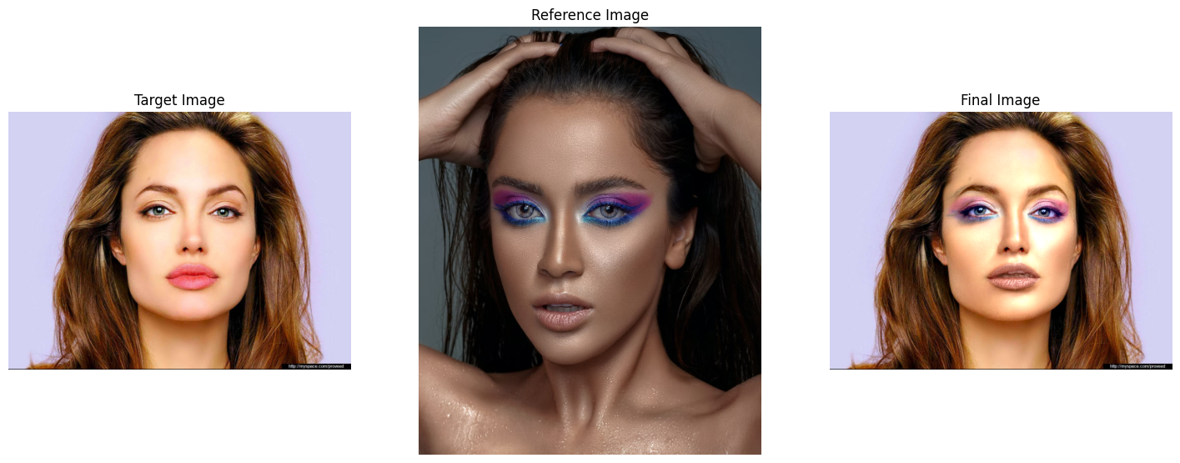
Introduction
This project aims to transfer makeup from a reference face to a target face
Automatic processing and makeup transfer.
No need to manually customize makeup using editing tools!
Reference paper

Slide 3
Makeup Transfer Flow Diagram
Facial Landmark Detection
Deep Learning Face Detection Models
Facial Alignment/Warping
Piecewise Affine Transform
Color Layers A, B
Layer Decomposition
RGB to CIE LAB Color Space
Weighted Least Squares
Large Scale/ Highlights Layer
Details Layer
Makeup Transfer
Poisson Blending
Weighted Transfer
Alpha Blending

Slide 4
Facial Landmark Detection

Slide 5
Facial Landmark Detection
Done using pretrained deep learning models
Tried and tested multiple face detection models – Google MediaPipe, Dlib.
Google MediaPipe face detection model is too complex for our task and often gives bad results.
We chose a mix between two pretrained Dlib face detection models combining the best landmarks of each model.
The following landmarks are detected –
Lower lip
Upper lip
Left eye
Right eye
Left eyebrow
Right eyebrow
Nose
Face Hull

Slide 6
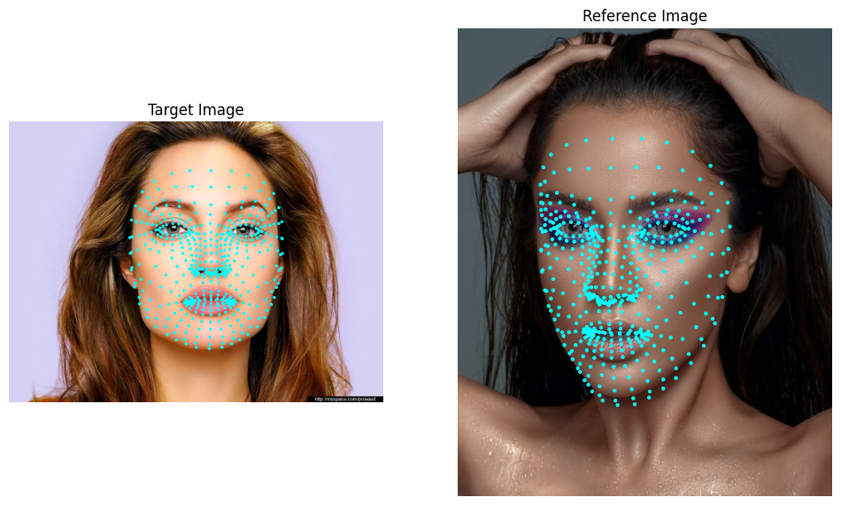
Google MediaPipe Face Detection

Slide 7
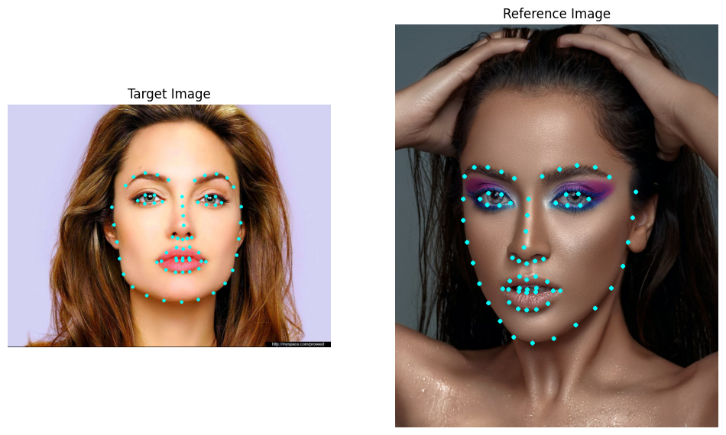
Dlib Face Detection 1

Slide 8

Dlib Face Detection 2

Slide 9
Facial Alignment/Warping

Slide 10
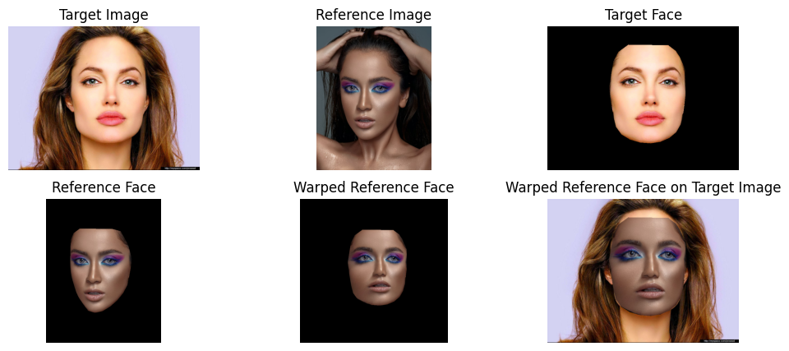
Facial Alignment/Warping
Piecewise Affine Transformation
Each facial landmark on the reference face is warped as per the target face.
The reference paper uses thin plane splining for warping, but we chose to use piecewise affine transformation due to its versatility and lesser computational complexity.

Slide 11
Preprocessing

Slide 12
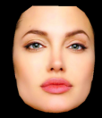
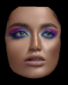
Preprocessing
Before layer decomposition, it is important to preprocess the warped reference face.
The skin color of the reference face is best matched to the target face.
Any hair obstructing the target face is removed.
This hair should be removed!
Reference face skin tone does not match target skin tone!

Slide 13
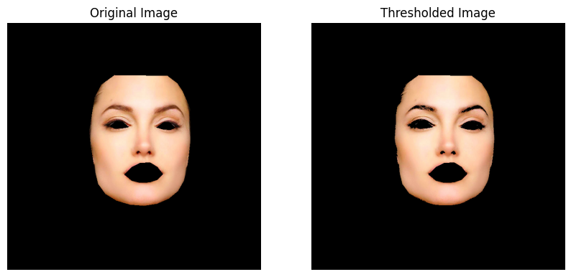
Hair Removal
Otsu’s Adaptive Thresholding
Otsu’s method is used to find the best cutoff intensity between hair and other regions.
This removes eyebrows and eyes etc., but these are added back later.
This hair should be removed!
Removed Hair

Slide 14
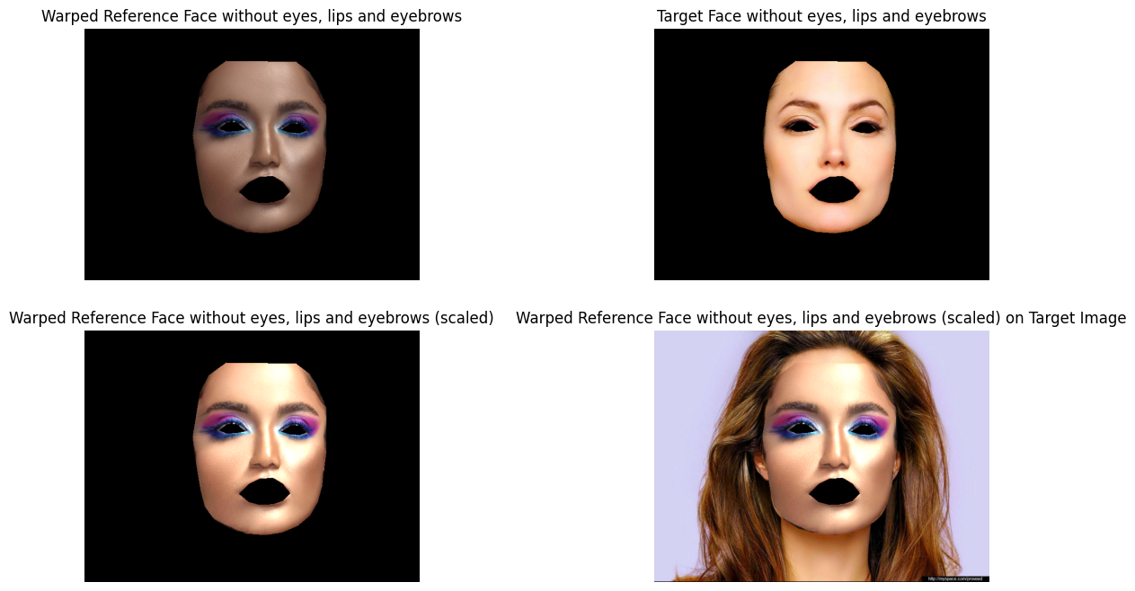
Skin Color Matching
Least Squares Linear Scaling
The R,G,B color channels in the cut areas of warped reference image were individually scaled linearly by a factor to have the least minimum mean squared error with the corresponding color channel in the target face.
Eyes and lips are removed beforehand to get the best skin tone matching!

Slide 15
Layer Decomposition

Slide 16
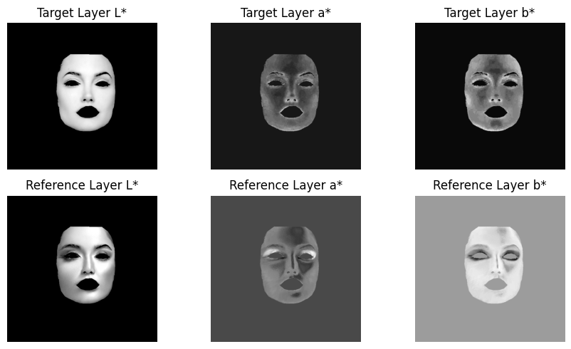
Layer Decomposition
Highlights, Detail Layer Decomposition
Layer decomposition is the most important step! It separates facial characteristics from the actual makeup.
The RGB color space is transformed into CIE L ∗ a ∗ b space where L refers to lightness (highlight) and a and b are the color channels. CIE L ∗ a ∗ b space allows for easy separation between highlight and color layers.

Slide 17
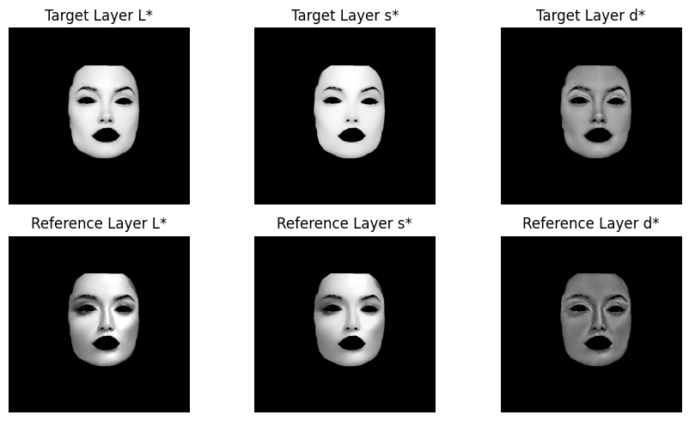
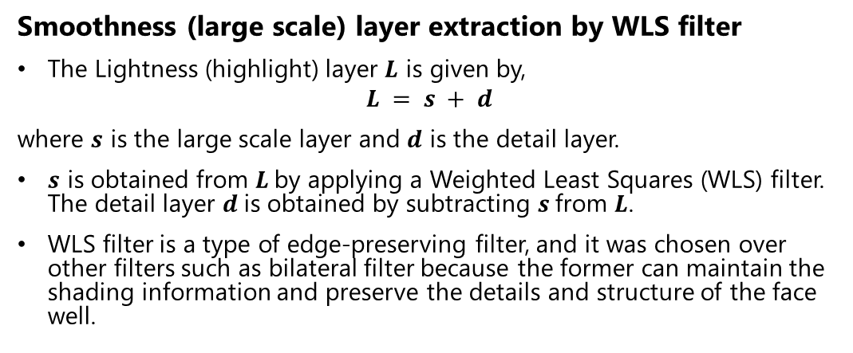
Layer Decomposition
Smoothness (large scale) layer extraction by WLS filter
The Lightness (highlight) layer $L$ is given by,
$$L = s + d$$
where $s$ is the large scale layer and $d$ is the detail layer.
$s$ is obtained from $L$by applying a Weighted Least Squares (WLS) filter. The detail layer $d$is obtained by subtracting $s$from $L$.
WLS filter is a type of edge-preserving filter, and it was chosen over other filters such as bilateral filter because the former can maintain the shading information and preserve the details and structure of the face well.

Slide 18
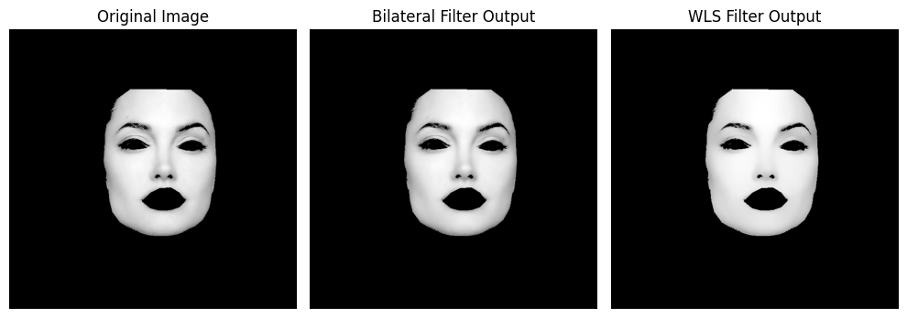
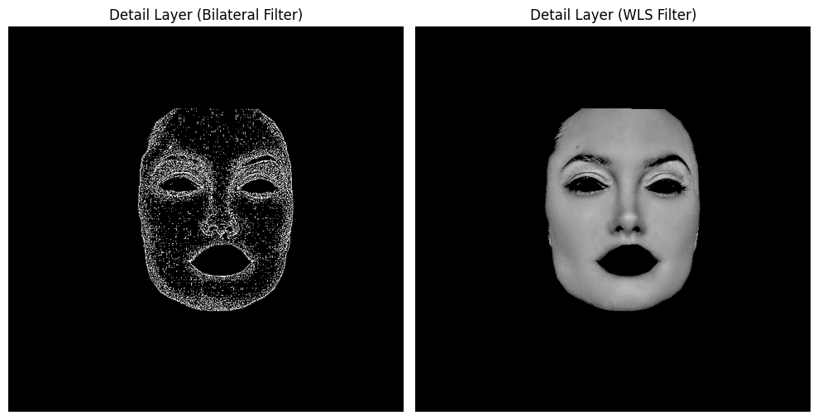
WLS Filter vs. Bilateral Filter
Clearly, bilateral filter does not extract details properly!

Slide 19
Makeup Transfer

Slide 20
Makeup Transfer
Combining of target and reference layers
The final smoothness, detail, highlight, and color layers are obtained using various blending methods.
Each layer requires a specific blending method as the information present in each layer is different.
Proper selection of blending method is required to obtain proper makeup transfer

Slide 21
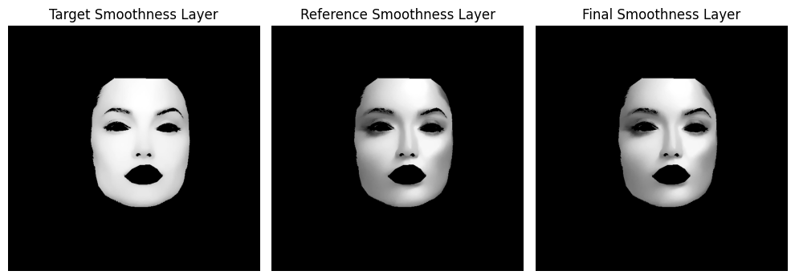
Makeup Transfer
Poisson blending for final smoothness layer
Unlike other image blending process, the makeup from the reference cannot be directly copied and pasted onto the target.
The target still needs to maintain its facial information while getting highlights and colors from the reference due to target.
Therefore, only the gradients of each image need to be edited and thus Poisson blending is done.

Slide 22
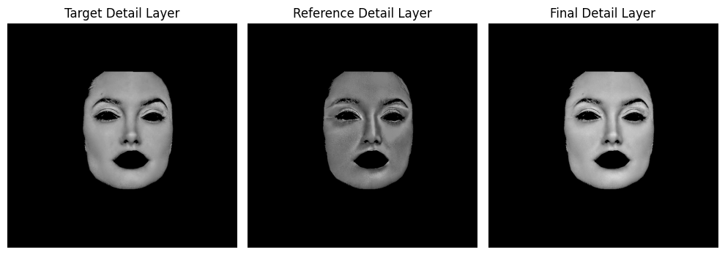
Makeup Transfer
Weighted summation for detail transfer
Detail layer is not affected by makeup and describes the inherent facial characteristics of the target and the reference.
Details layer can be obtained by the weighted sum of the target’s detail and the reference’s detail layer.

Slide 23
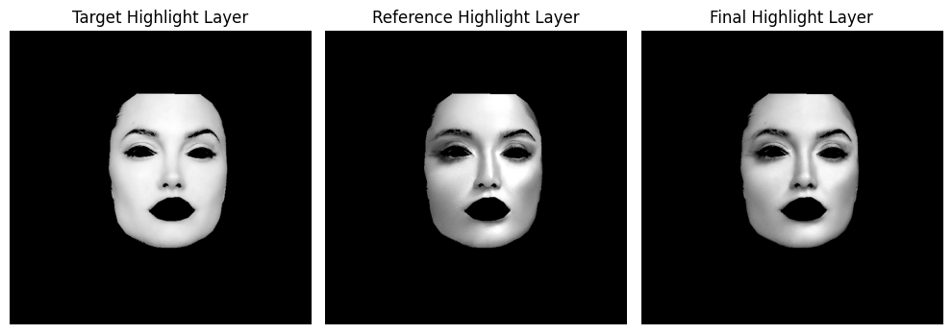
Makeup Transfer
Final highlight layer
The L layer is obtained by direct summation of final smoothness and detail layer.

Slide 24
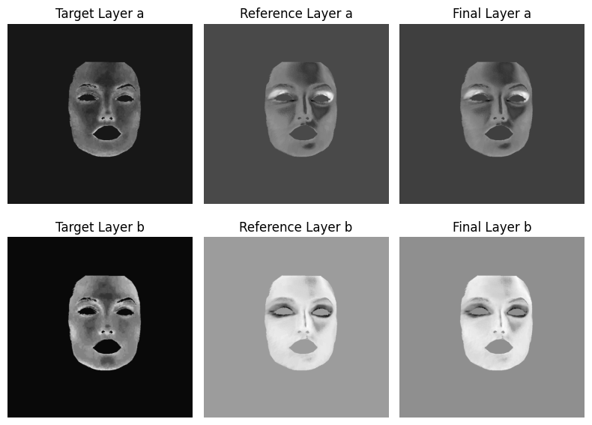
Makeup Transfer
Alpha blending for color transfer
.The a, b layers are obtained by alpha blending the respective a and b channels of the target face and reference face.

Slide 25
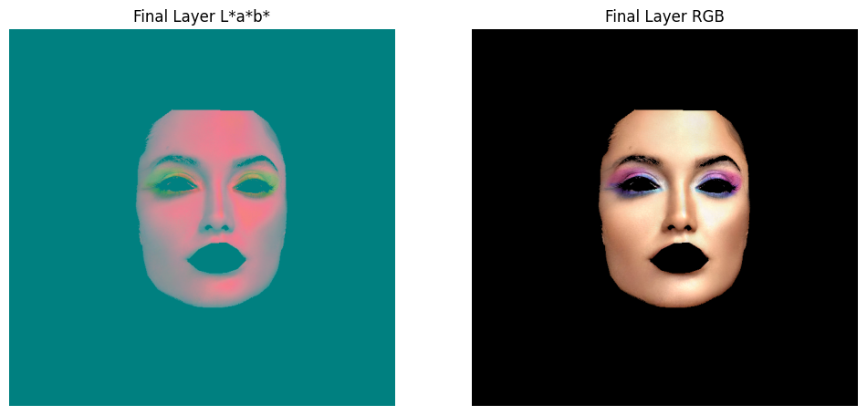
Makeup Transfer
Final RGB layer
.The final RGB layer is obtained by LAB to RGB conversion.

Slide 26
Lip Makeup Transfer

Slide 27
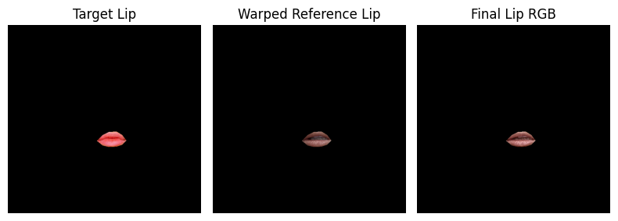
Lip Makeup Transfer
Separate processing for lip makeup transfer
.The same processing steps are followed separately just for the lips to obtain lip makeup transfer.

Slide 28
Face Blending

Slide 29
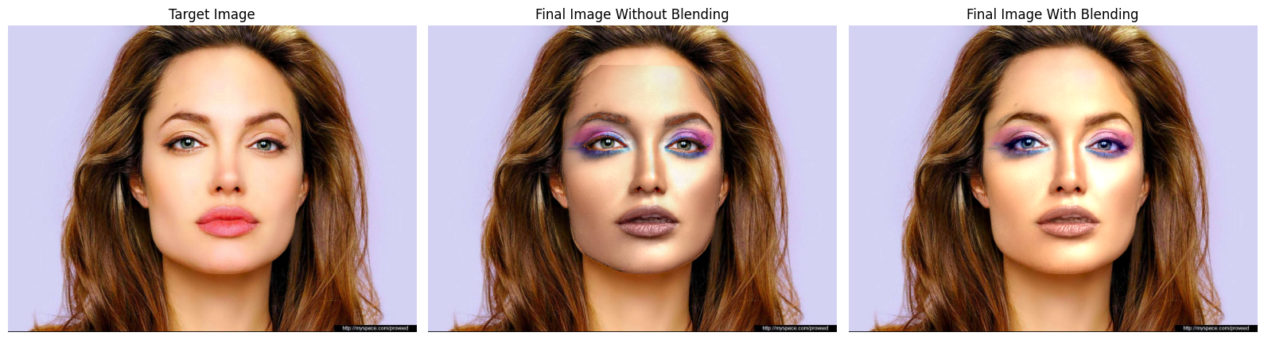
Face Blending
Foreground-background blending
.It is vital to blend the foreground face and background properly to obtain a proper output.
OpenCV’s seamlessClone is used to properly blend the foreground and background together to obtain a seamless stitch!

Slide 30
Final Output

Slide 31
Output 1

Slide 32
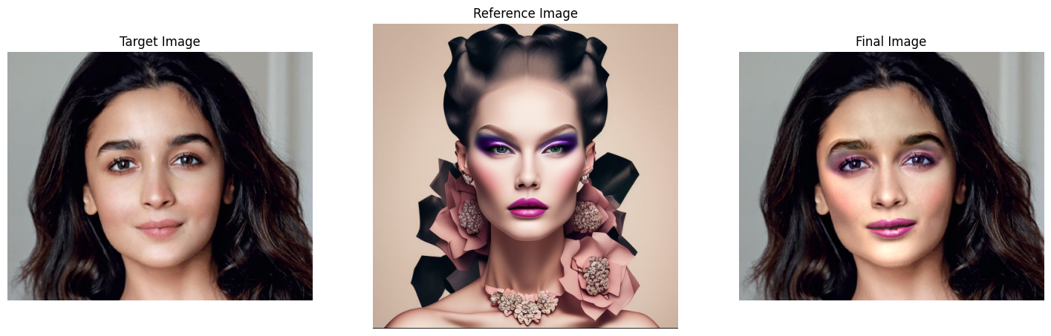
Output 2

Slide 33
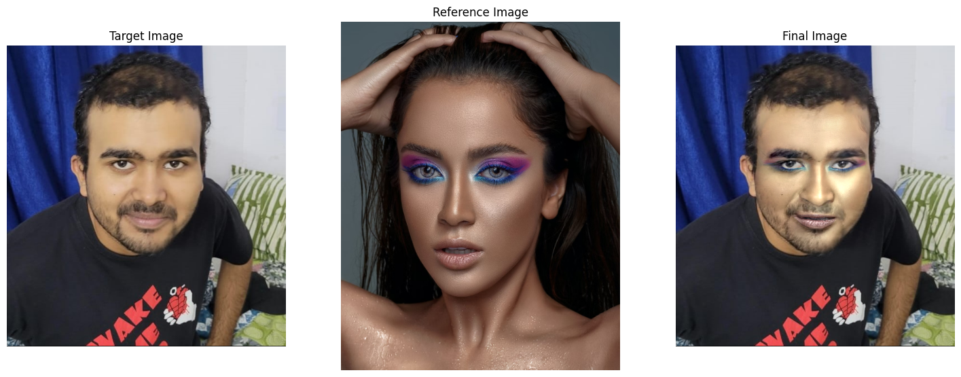
Output 3
Notice how facial hair is retained!

Slide 34
Improvements

Slide 35
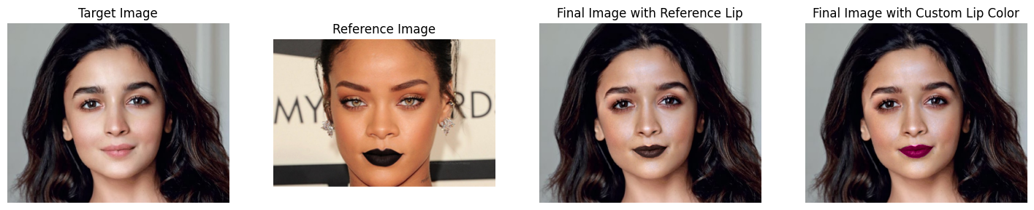
Custom Lip Color
Instead of transferring the reference lip color, we provide a custom lip color to be transferred!

Slide 36
Scope of the Project

Slide 37
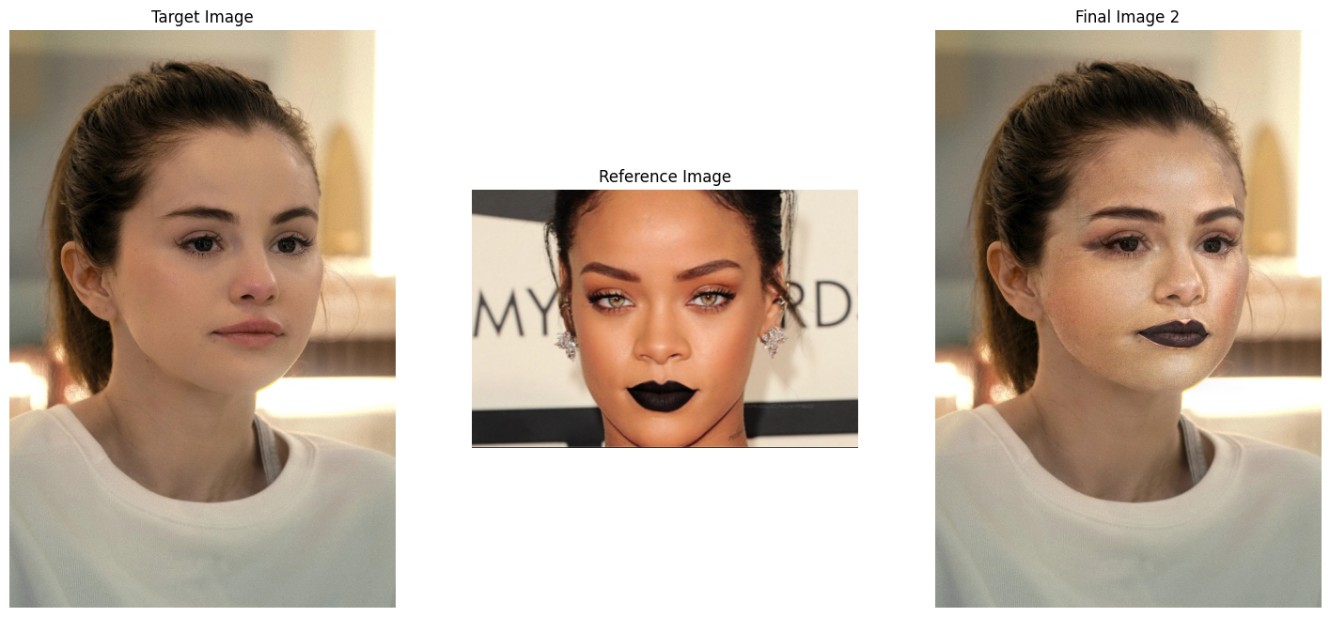
Only As Good As the Face Detection Model!
Proper warping and alignment is crucial for proper makeup transfer.
This depends on how well the model can detect the facial landmarks.
Improper landmark detection can affect the result.
Notice how this part is not proper.

Slide 38
Thank You

